Slide 1
Resident Life Survey Analysis Isabella Pastorino and Carly Richards 04/14/2026
Notes:
Isabella: Hello, today we will be presenting our findings on the resident life surveys that are sent out to students each year.
Carly: These surveys ask students who live on campus a variety of questions about safety, facilities, dining hall experience, and resident assistant relationships.

Slide 2
Agenda
Survey Responsiveness
Safety
Facilities
Dining Experience
Belonging and Community
Key Takeaways
Suggestions
Questions
Notes:
Isabella: We will start with a year-to-year comparison of statistics about the survey from the years 2023 to 2026. We will then dive into how safe students feel around campus.
Carly: Then we will discuss the facilities around campus, students dining hall experience, and their overall feeling of belonging and community within the campus.
TODO: Make sure to talk about how we defined these scores as a way to group certain question types together. i.e. “We turned each survey response into a 1-5 number, grouped related questions by topic (like RA, staff, safety, facilities, community, and outcomes), and took the average so each topic has one easy score.”

Slide 3
Response Rates by Academic Year
2023-24
2024-25
2025-26
Notes:
Ben: Someone is going to ask why this dropped from 23-24 to other years. The answer to this question is that the drop was mostly a total population drop. No single building, class, or athletic cohort stood out.

Slide 4
Safety Around Campus
Safety scores at Grand View are our highest scores.
Notes:
Isabella: Safety scores at Grand View are out highest scores. But we could achieve small wins by adding lights outside.

Slide 5
Safety Comments
L Apartments have the lowest safety score.
Knudsen has the highest safety score.
“Not enough lights outside, safety measures could be better around Grand View.” – L Apartment Resident
“Campus security doesn’t seem like they know what to do during most circumstances; they make things worse during a room incident.” – L Apartment Resident
Notes:
Carly: When we looked at our campus safety scores overall, we found a few trends. The L apartments have the lowest safety score, and Knudsen has the highest safety score. We do not really know why this is the case, but we have inferred it is due to the location of these dorms on campus. Students had some suggestions for us to help improve our safety scores, one student had the simple idea of putting more lights around campus. There were also multiple complaints about campus security, students said they would escalate situations, lacked knowledge of what to do, and were not the nicest.
Isabella: The L apartments are on the edge of campus right up against south-east fourteenth, giving us the idea that students do not feel as safe because they are right by a major road as well as being on the very edge of campus. The Knudsen dorms are right in the heart of campus, giving us the idea that students feel safer because they are surrounded by Grand View buildings and are not close to a major road. Although we can not move the L apartment to a different location, we can still make students feel safer by adding more lights around it and in the parking lot.

Slide 6
Facilities Around Campus
Facility scores are our biggest area for improvement, specifically at Nielsen and Knudsen.
Notes:
Carly: The facilities around campus are our biggest area for improvement, specifically the dorms Nielsen and Knudsen. The main concerns about these facilities were the room cleanliness upon move-in and many issues with laundry machines.

Slide 7
Facilities Issues & Opportunities
Free Laundry
Broken Laundry Machines
Cleanliness Issues in Shared Bathrooms
Pests in Dorms
Notes:
Isabella: When reviewing the free form responses within the surveys we found some common themes. Students want free laundry there were countless complaints about the laundry machines always being broken, the overall cleanliness of shared bathrooms, and pests in dorms were what we found.

Slide 8
L Apartments Survey Findings
Response Rate
20%
Significant Decline Across
Resident Assistant Support
University Staff
University Events
Overall Safety
Facilities

Slide 9
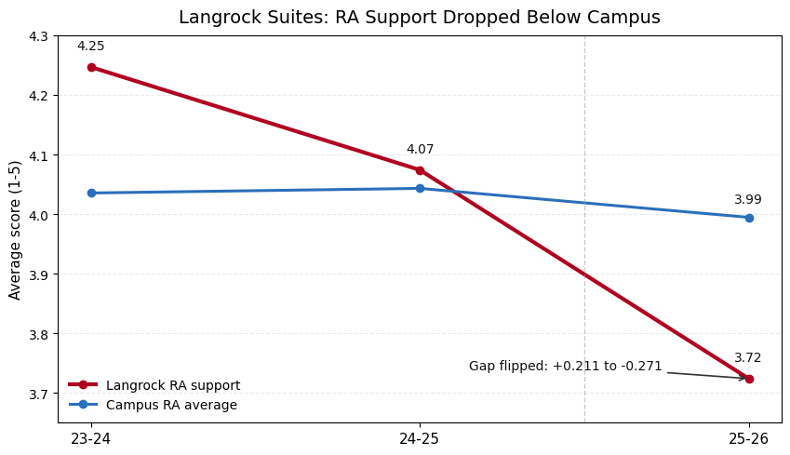
Langrock Suites
Survey Findings
Response Rate
54%
RA decline appears concentrated in approachability and relationship-building, not basic professionalism.
Largest item drops were “helped me get to know others” (-0.78) and “tried to get to know me” (-0.73).

Slide 10
Hull Apartments & Suites
Survey Findings
Response Rate
10%
Response Rate: ~10%
Key Findings:
Poor RA Support
Reduced Interest in 2025

Slide 11
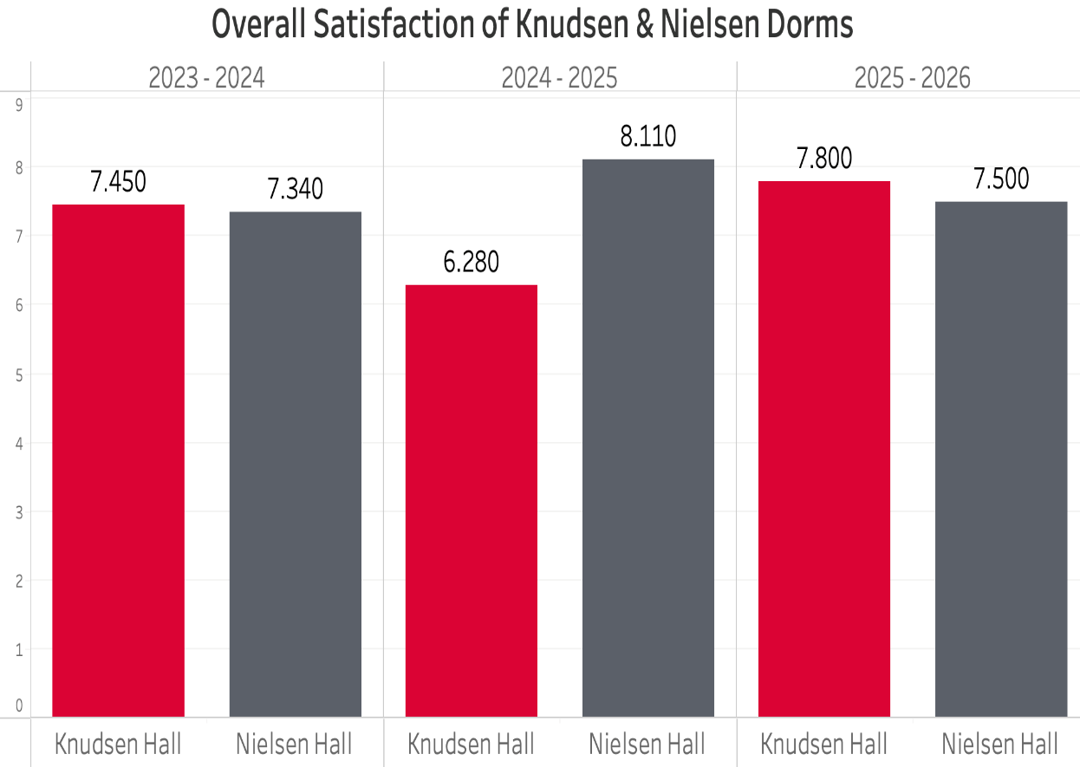
Nielsen & Knudsen Analysis
Response Rate: Very Low
Key Findings:
Cleanliness Issues
Pests and Rodents

Slide 12
Facilities Summary
Feedback
Suggestions
Laundry is Costly
Machines Often Out of Order
Poor Dorm Cleanliness at Move-In
Communal Bathrooms in Knudsen/Nielsen Lack Cleanliness
Very Loud During Quiet Hours
Include Laundry in Housing Fees
Check each residence room prior to move-in for cleanliness and ensure that everything is operational
Improve Daily Cleaning
Whiteboard in Lounges
Investigate and Enforce Marijuana Odors
Enforcing Quiet Hours
Notes:
Carly: From looking at the students free form responses we got some more feedback, the main concerns being that laundry is very costly, the laundry machines are often out of order, the dorms are not up to par upon move-in, and the communal bathrooms in Knudsen and Nielsen lack the appropariate cleanliness.
Isabella: We have some suggestions to improve facility scores. Routine maintenance checks on the laundry machines, and free laundry, it could even be built into the housing fee. Ensuring each residence room prior to move-in is up to par. For the communal bathrooms more regularly in-depth cleaning to contian odors. Ensuring that the resident assistants are enforcing quiet hours, and students want white-boards in their lounges.

Slide 13
Dining Experience
Students reported several dining ideas and suggestions in their free-form responses.
Notes:
Carly: Next, is dining experience. Although we do not have a way to score dining experince, students still reported several dining ideas and suggestions in their free-form respones.

Slide 14
Dining
More Fresh Fruit and Vegetables
Perception of Poor Quality Meat
Greater Variety for Dietary Restrictions
Ensuring Food Meets Safety Standards
Diversity in Meal Options
Notes:
Isabella: Students want more fresh fruits and vegetables, fresh meat options, a greater variety for students with dietary restrictions, ensuring that the food meets safety standards, and many students complained that the food options are very repetitive.

Slide 15
Dining Summary
Feedback
Suggestions
Friendly Staff and Reported Improvements
Not Enough Fresh Protein Options
Healthy Options Are Dull and Lack Variety
Meal Options Are Repetitive
More Flexible Dining Hall Hours
Add More Fresh Fruit and Vegetable Options
Extend Breakfast Hours by an Additional Hour
Meal Ideas From Students:
Tacos
Healthy Rice Bowls
Daily Chicken Nuggets
Chicken Wing
Diversity (More Mexican, Korean, Chinese, etc.)
Healthy Potatoes
Notes:
Carly: The dining experience free-form responses indicated numerous things, that the staff are very friendly and good overall improvements from year-to-year, there is not enough fresh protein options, the healthy options are dull and lack variety, the meal options are repetitive, and students want more dining hall hours, such as breakfast being served an hour later.
Isabella: We have numerous suggestions to improve the dining hall experience. First, we can add more fresh fruits, vegetables, and mean, extend breakfast hours by and addition hall, then have more meal options such as tacos, healthy rice bowls, daily chicken nuggets, chicken wings, healthy potatoes, and overall, a more diverse selection of foods.

Slide 16
Belonging & Community Around Campus
Students have a strong sense of belonging on campus.
Notes:
Carly: Belonging and community around campus is great. Students have a strong sense of belonging on campus, driving students to connect through events, sports, and classes.

Slide 17
Belonging & Community
SAC / REC Programs
Bingo
Ping Pong
Weekend Events
Notes:
Isabella: Some suggestions from students is that they want to see more SAC / REC programs, bingo, weekend events, ping pong, and just overall more fun events!

Slide 18
Belonging & Community Summary
Resident Survey Data Shows:
Suggestions
Having a mentor on campus shows the highest association with community belonging
Residential community experience is a major driver of connection
REC/SAC events and intramural participation are strongly associated with higher community scores
Athletic participation is the dominant connection pathway due to both strong scores and high participation
More mentorship opportunities for underclassmen and transfer students
More REC/SAC Events on Weekends
Ping-Pong Tables in Dorms
Commuter Student-Specific Events
Notes:
Isabella: Some common themes we found in the data is that having a mentor on campus shows the highest association with community belonging. Residential community experience is a major driver in connection, REC, SAC, and intramurals events and participations are strongly associated with higher community sores, and athletic participation is the dominant connection pathway due to both strong scores and high participation.
Carly: Some suggestions we have are that there should be more mentorship opportunities for underclassmen and transfer students, REC / SAC events should be available during the weekend and add ping pong tables in the dorms.

Slide 19
Key Takeaways - Safety, Dining, and Belonging
Safety is a major strength on campus
Consider lighting improvements
Facilities are the biggest opportunity for improvement
Students desire more variety, healthier options, and extended hours from dining
Driven by events, athletics, and mentorship opportunities, a strong sense of community exists
Notes:
Isabella: The key takeaways is that safety is a major strength on campus, with only minor improvements and facilities are the biggest opportunity for improvement, especially the cleanliness and laundry reliability.
Carly: Dining can be enhanced with more variety, healthier options, and extended hours, and a strong sense of community exists, driven by events, athletics, and mentorship opportunities.

Slide 20
Key Takeaways – Facilities and Survey
Significant Drop in Survey Response Rates
L Apartments are Declining
Resident Assistant Performance
Reduced Interest in Hull Suites
Some Halls Lack Usable Data
Overall Cleanliness of Facilities

Slide 21
Suggestions
Address RA Performance Issues
Review Resident Assistant Training
Lack of Rule Enforcement
Increase Survey Response Rates
Better Incentives (gift cards, raffles, etc.)
Shorter Surveys
Better Timing and Reminders
Messages Showing Impact of Responses

Slide 22
Questions?
Notes:
Isabella: Does anyone have any questions?
Carly: Thank you!

